Slide 1
Best community engagement through social media channels
Gulf News submission for
XMA Cross Media Awards 2012
Team: Anupa Kurian, Sanya Nayeem, Rabab Khan, Manuel Almario, Noor Al Khatib, Heather Madore, Huda Tabrez and Mohammad Jihad

Slide 2
What do we do? And why?
Gulf News launched its concept of Community Reports over two years ago.
It was an attempt to give voice to the residents of the country and bring in more transparency at the level of civic governance.
We publish an average of one community report every day, with a 50 per cent resolution rate. Creeks get cleaned, potholes get filled, road signs get sorted, garbage skips get cleared and bus stops are serviced.
Gulf News has published over 1000 community reports to date.
Readers get awarded by government bodies for helping make the country a cleaner, better place to live in, based on their community reports that have been published.

Slide 3
How does social media help?
The community report raises questions and issues based on reader tip-offs and submissions on our Facebook page: ‘Gulf News Al Nisr Publishing UAE’ and Twitter handle @GN Readers.
Each community journalist is mentored by an editor. And once it is published, it gets promoted on our social media channels – promoting debate, interaction and more reports.
It generates real, journalistic and social change through qualitative crowd sourcing via the Facebook page.

Slide 4
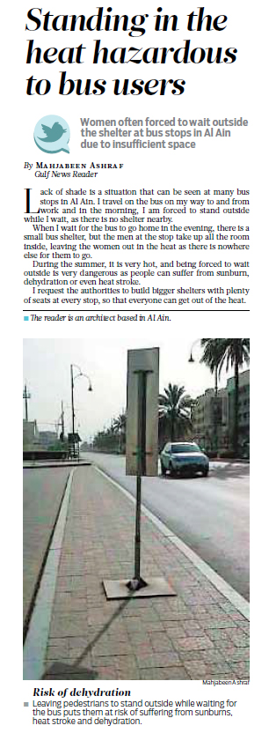
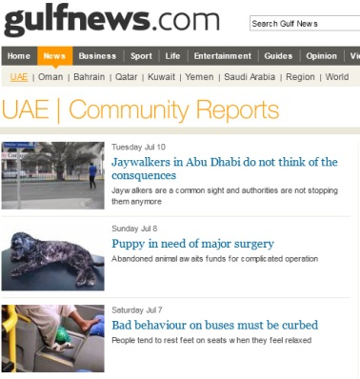
Best community engagement
The community report tip-offs come in from Facebook and Twitter. They are comments, pictures, direct messages and video uploads.
Each is evaluated and responded to within a specified time window.
Nothing goes unanswered on our reader interactivity social media channels
Editors are assigned to mentor community journalists. These community reports are printed, placed on our website and promoted on Facebook.

Slide 5
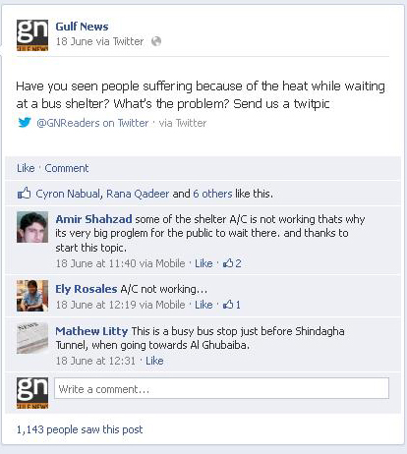
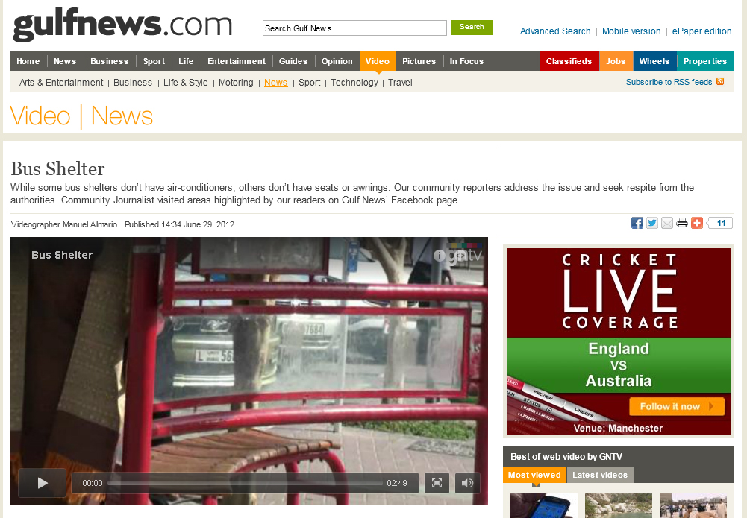
Best community engagement (contd)
Community reports are done through both text, pictures and multimedia packages.

Slide 6
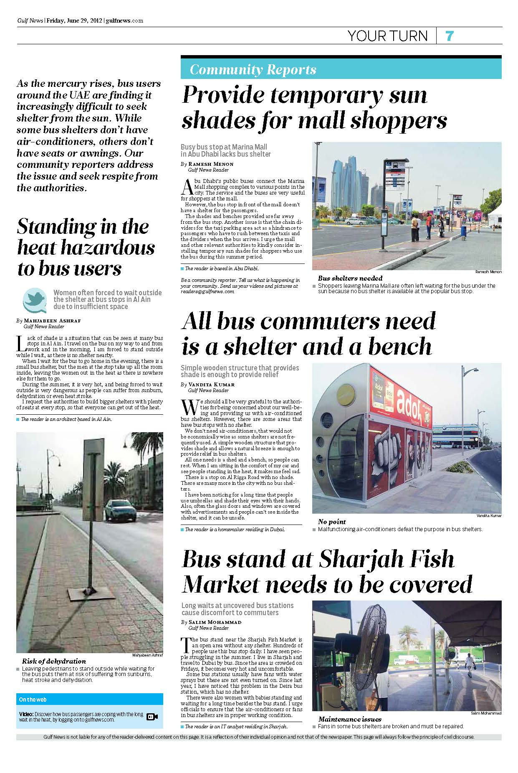
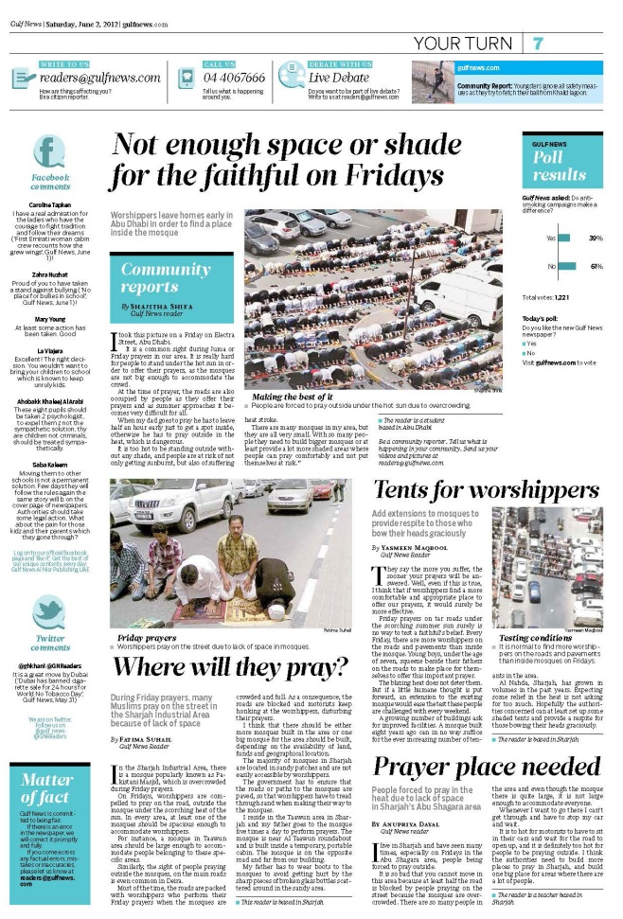
Best community engagement (contd)
We averaged about 1000 community reports in over two years. We also do several full page special reports.

Slide 7
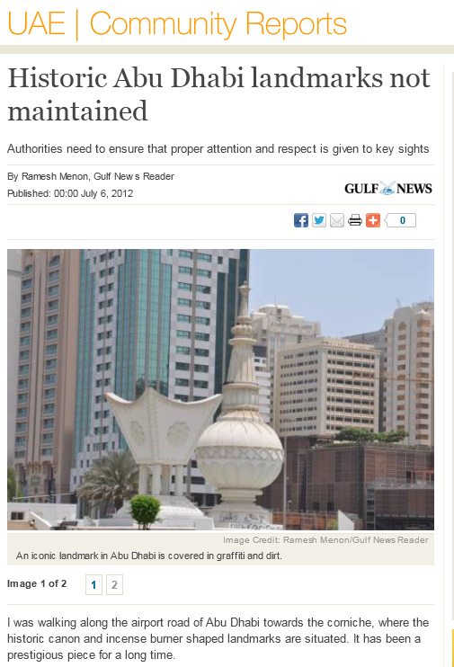
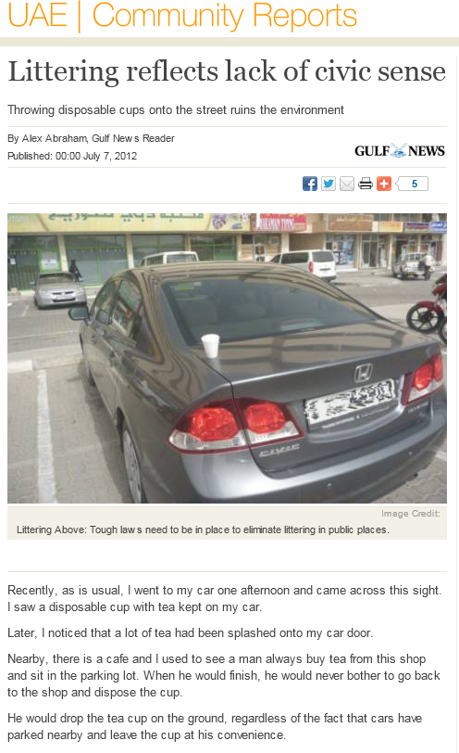
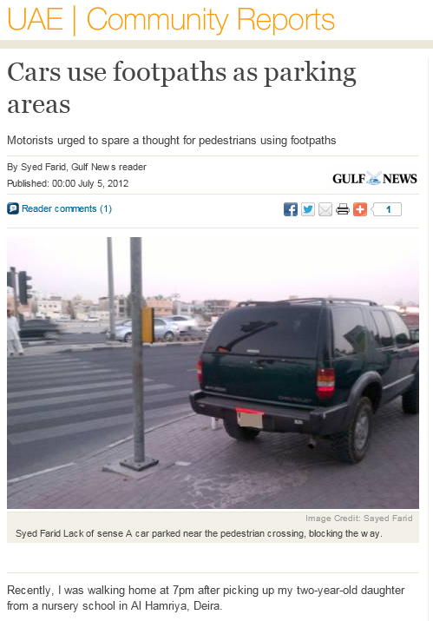
Best community engagement (contd)
Community reports play a unique role in a country where local resident issues may not have a clear process and escalation of the issue has resulted in resolutions. There is also a multi-platform promotion, which adds to Gulf News branding/reading experience and helps make the newspaper a point of reference in the country.

Slide 8
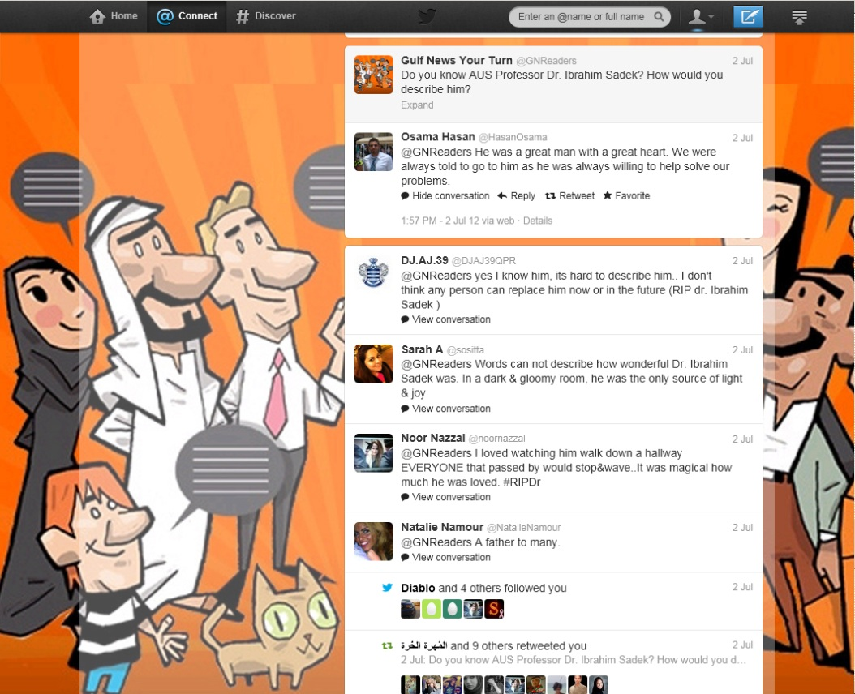
Best community engagement (contd)
Twitter interaction – generates debate and dialogue
We might pick a thread of conversation from the community report to start a thread.

Slide 9
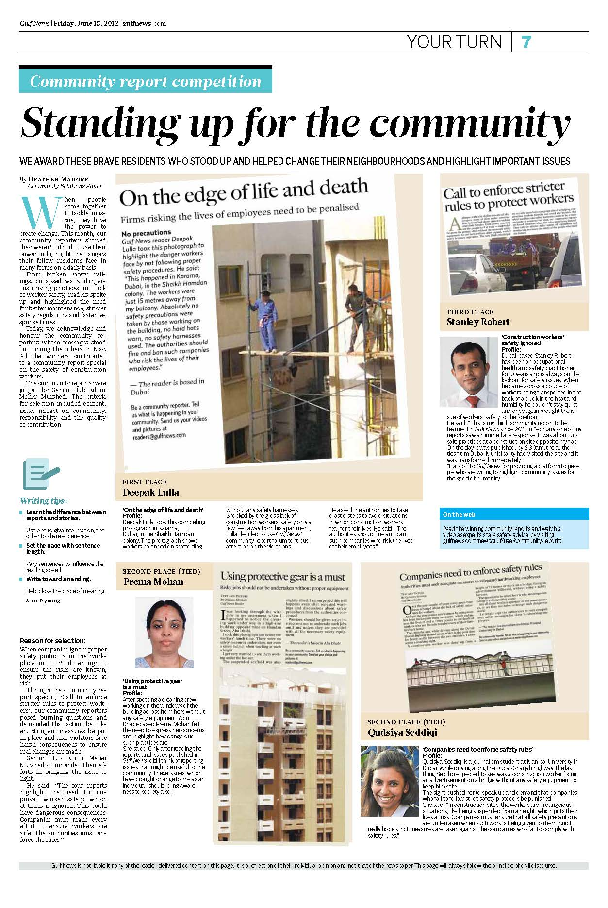
Best community engagement (contd)
Readers get awarded every month. Many of them also get recognised by the local municipal bodies for their efforts.

Slide 10
Best community engagement (contd)
Gulf News has been engaging its readers through multiple channels, across print, website, social media and now the iPad.
Social media has helped us harness this high level of interactivity in a more cohesive and measurable manner.
Thank you

